Slide 1
The Physical Layer
Chapter 2
Computer Networks, Fifth Edition by Andrew Tanenbaum and David Wetherall, © Pearson Education-Prentice Hall, 2011

Slide 2
Theoretical Basis for Data Communication
Fourier analysis
Bandwidth-limited signals
Maximum data rate of a channel
Computer Networks, Fifth Edition by Andrew Tanenbaum and David Wetherall, © Pearson Education-Prentice Hall, 2011

Slide 3
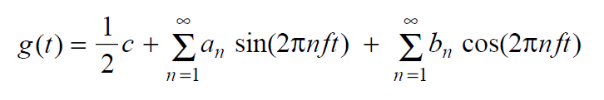

Fourier Analysis
We model the behavior of variation of voltage or current with mathematical functions
Fourier series is used
Function reconstructed with
Computer Networks, Fifth Edition by Andrew Tanenbaum and David Wetherall, © Pearson Education-Prentice Hall, 2011

Slide 4
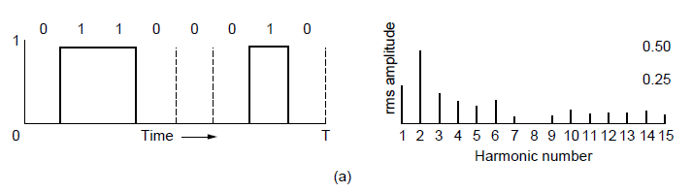
Bandwidth-Limited Signals (1)
A binary signal and its root-mean-square
Fourier amplitudes.
Computer Networks, Fifth Edition by Andrew Tanenbaum and David Wetherall, © Pearson Education-Prentice Hall, 2011

Slide 5
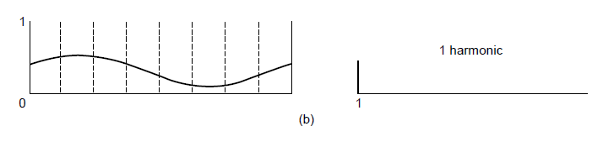
Bandwidth-Limited Signals (2)
(b)-(e) Successive approximations
to the original signal.
Computer Networks, Fifth Edition by Andrew Tanenbaum and David Wetherall, © Pearson Education-Prentice Hall, 2011

Slide 6
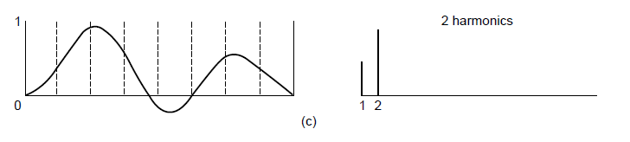
Bandwidth-Limited Signals (3)
(b)-(e) Successive approximations
to the original signal.
Computer Networks, Fifth Edition by Andrew Tanenbaum and David Wetherall, © Pearson Education-Prentice Hall, 2011

Slide 7
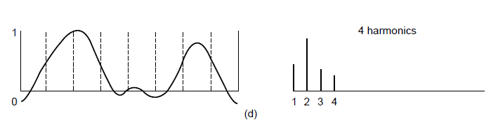
Bandwidth-Limited Signals (4)
(b)-(e) Successive approximations
to the original signal.
Computer Networks, Fifth Edition by Andrew Tanenbaum and David Wetherall, © Pearson Education-Prentice Hall, 2011

Slide 8
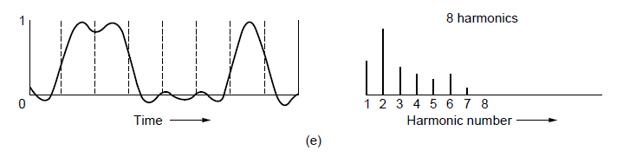
Bandwidth-Limited Signals (5)
(b)-(e) Successive approximations
to the original signal.
Computer Networks, Fifth Edition by Andrew Tanenbaum and David Wetherall, © Pearson Education-Prentice Hall, 2011

Slide 9
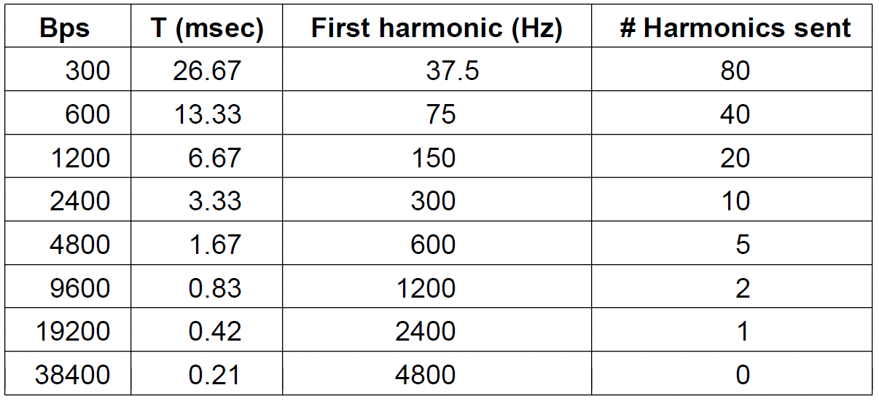
Bandwidth-Limited Signals (6)
Relation between data rate and
harmonics for our example.
Computer Networks, Fifth Edition by Andrew Tanenbaum and David Wetherall, © Pearson Education-Prentice Hall, 2011

Slide 10
The Maximum Data Rate of a Channel
Nyquist’s theorem
Shannon’s formula for capacity of a noisy channel
Computer Networks, Fifth Edition by Andrew Tanenbaum and David Wetherall, © Pearson Education-Prentice Hall, 2011

Slide 11
Guided Transmission Media
Magnetic media
Twisted pairs
Coaxial cable
Power lines
Fiber optics
Computer Networks, Fifth Edition by Andrew Tanenbaum and David Wetherall, © Pearson Education-Prentice Hall, 2011

Slide 12
Magnetic Media
Write data onto magnetic media
  Disks
  Tapes
Data transmission speed
  Never underestimate the bandwidth of a station wagon full of tapes hurtling down the highway.
Computer Networks, Fifth Edition by Andrew Tanenbaum and David Wetherall, © Pearson Education-Prentice Hall, 2011

Slide 13
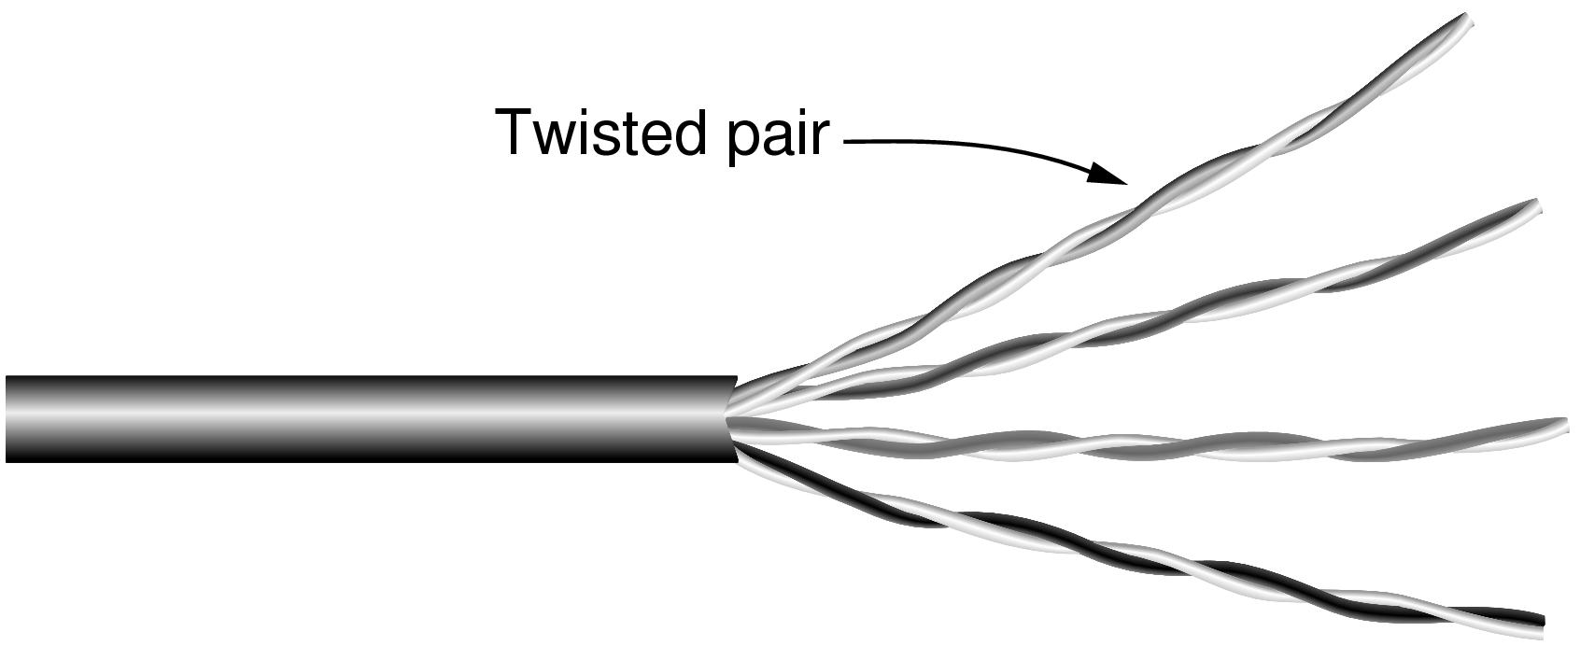
Twisted Pairs
Category 5 UTP cable with four twisted pairs
Computer Networks, Fifth Edition by Andrew Tanenbaum and David Wetherall, © Pearson Education-Prentice Hall, 2011

Slide 14
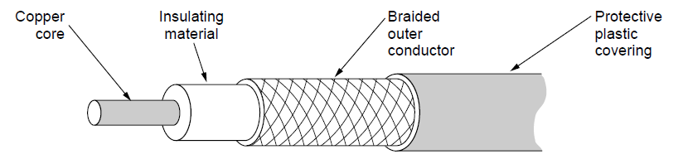
Coaxial Cable
A coaxial cable
Computer Networks, Fifth Edition by Andrew Tanenbaum and David Wetherall, © Pearson Education-Prentice Hall, 2011

Slide 15
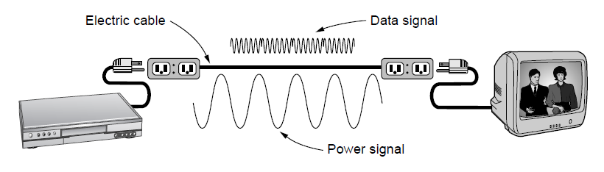
Power Lines
A network that uses household electrical wiring.
Computer Networks, Fifth Edition by Andrew Tanenbaum and David Wetherall, © Pearson Education-Prentice Hall, 2011

Slide 16
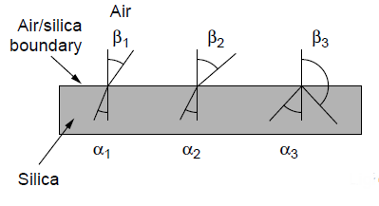
Fiber Optics (1)
Three examples of a light ray from inside a
silica fiber impinging on the air/silica boundary
at different angles.
Computer Networks, Fifth Edition by Andrew Tanenbaum and David Wetherall, © Pearson Education-Prentice Hall, 2011

Slide 17
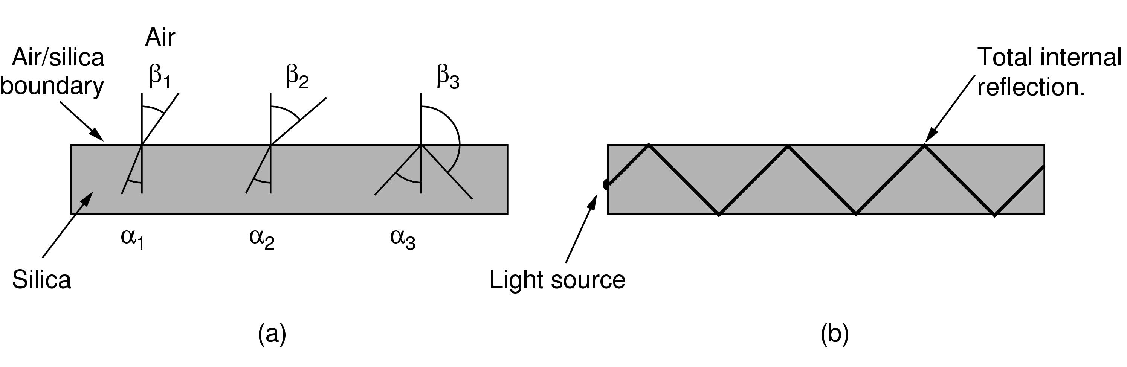
Fiber Optics (2)
Light trapped by total internal reflection.
Computer Networks, Fifth Edition by Andrew Tanenbaum and David Wetherall, © Pearson Education-Prentice Hall, 2011

Slide 18
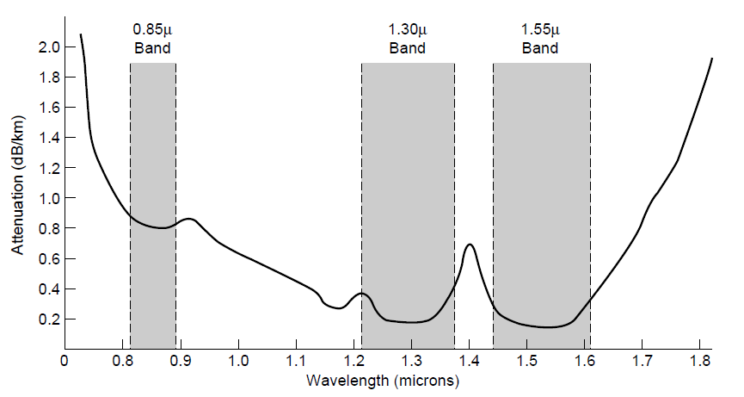
Transmission of Light Through Fiber
Attenuation of light through fiber
in the infrared region
Computer Networks, Fifth Edition by Andrew Tanenbaum and David Wetherall, © Pearson Education-Prentice Hall, 2011

Slide 19
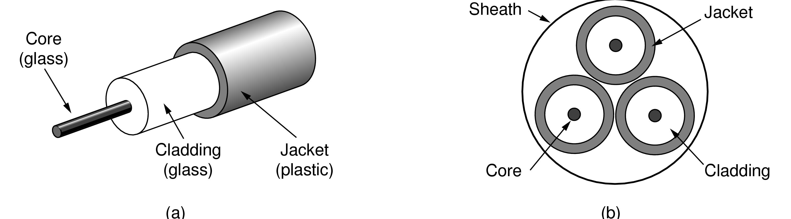
Fiber Cables (1)
Views of a fiber cable
Computer Networks, Fifth Edition by Andrew Tanenbaum and David Wetherall, © Pearson Education-Prentice Hall, 2011

Slide 20
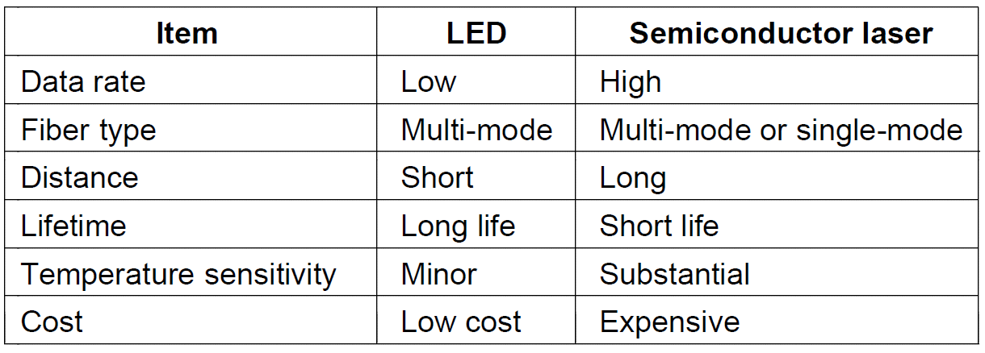
Fiber Cables (2)
A comparison of semiconductor diodes
and LEDs as light sources
Computer Networks, Fifth Edition by Andrew Tanenbaum and David Wetherall, © Pearson Education-Prentice Hall, 2011

Slide 21
Wireless Transmission
The Electromagnetic Spectrum
Radio Transmission
Microwave Transmission
Infrared Transmission
Light Transmission
Computer Networks, Fifth Edition by Andrew Tanenbaum and David Wetherall, © Pearson Education-Prentice Hall, 2011

Slide 22
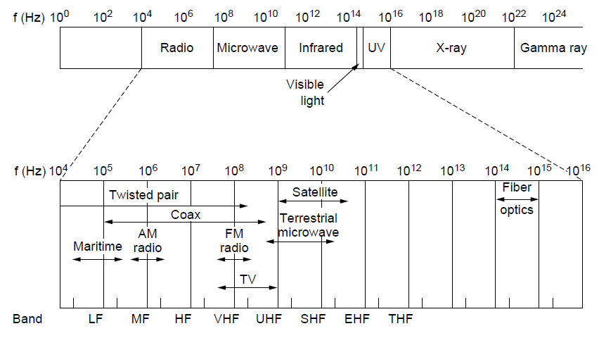
The Electromagnetic Spectrum (1)
The electromagnetic spectrum and
its uses for communication
Computer Networks, Fifth Edition by Andrew Tanenbaum and David Wetherall, © Pearson Education-Prentice Hall, 2011

Slide 23
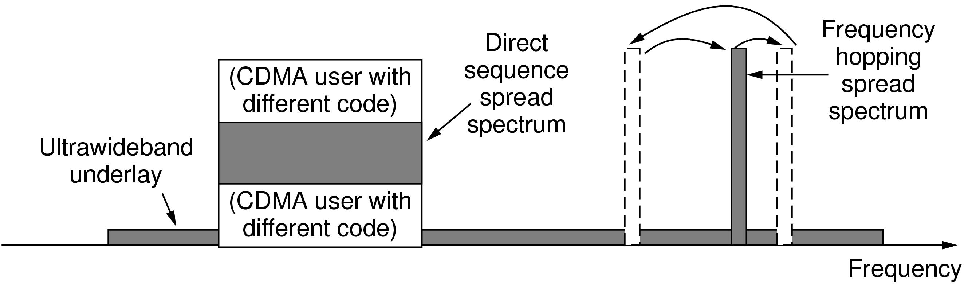
The Electromagnetic Spectrum (2)
Spread spectrum and ultra-wideband
(UWB) communication
Computer Networks, Fifth Edition by Andrew Tanenbaum and David Wetherall, © Pearson Education-Prentice Hall, 2011

Slide 24
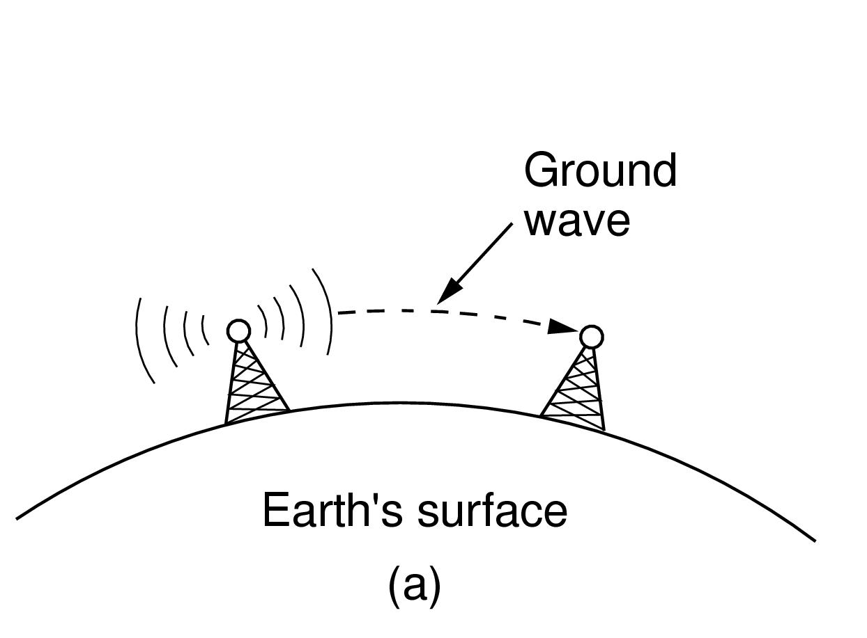
Radio Transmission (1)
In the VLF, LF, and MF bands, radio waves follow the curvature of the earth
Computer Networks, Fifth Edition by Andrew Tanenbaum and David Wetherall, © Pearson Education-Prentice Hall, 2011

Slide 25
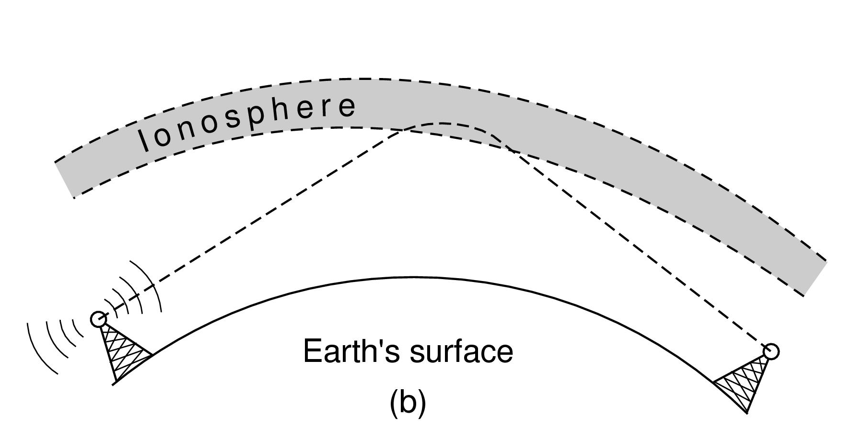
Radio Transmission (2)
In the HF band, they bounce off the ionosphere.
Computer Networks, Fifth Edition by Andrew Tanenbaum and David Wetherall, © Pearson Education-Prentice Hall, 2011

Slide 26
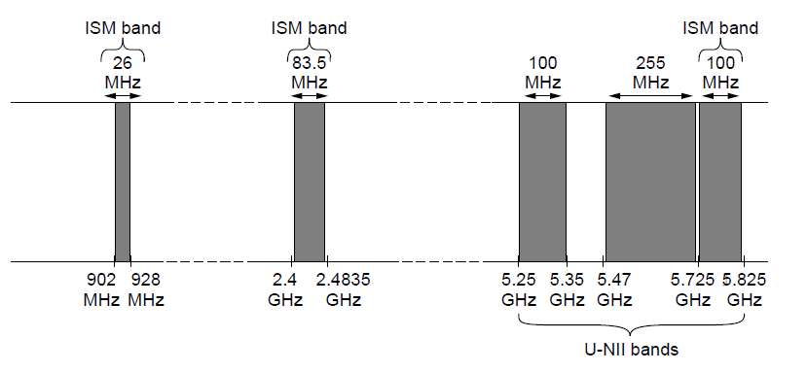
The Politics of the Electromagnetic Spectrum
ISM and U-NII bands used in the
United States by wireless devices
Computer Networks, Fifth Edition by Andrew Tanenbaum and David Wetherall, © Pearson Education-Prentice Hall, 2011

Slide 27

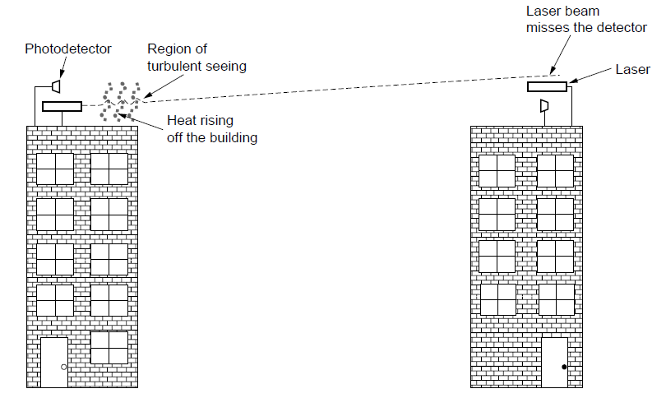
Light Transmission
Convection currents can interfere with laser communication systems. A bidirectional system with two lasers is pictured here.
Computer Networks, Fifth Edition by Andrew Tanenbaum and David Wetherall, © Pearson Education-Prentice Hall, 2011

Slide 28
Communication Satellites
Geostationary Satellites
Medium-Earth Orbit Satellites
Low-Earth Orbit Satellites
Satellites Versus Fiber
Computer Networks, Fifth Edition by Andrew Tanenbaum and David Wetherall, © Pearson Education-Prentice Hall, 2011

Slide 29
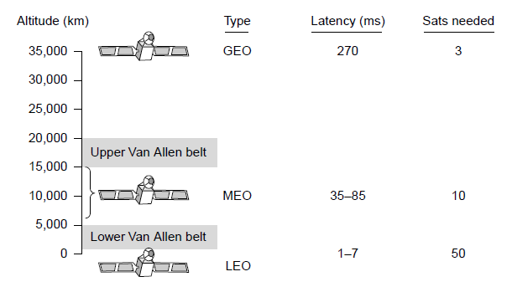
Communication Satellites
Communication satellites, some properties, including: altitude above earth, round-trip delay time, number of satellites for global coverage.
Computer Networks, Fifth Edition by Andrew Tanenbaum and David Wetherall, © Pearson Education-Prentice Hall, 2011

Slide 30
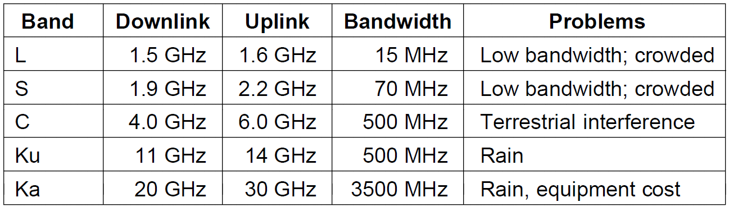
Geostationary Satellites (1)
The principal satellite bands
Computer Networks, Fifth Edition by Andrew Tanenbaum and David Wetherall, © Pearson Education-Prentice Hall, 2011

Slide 31
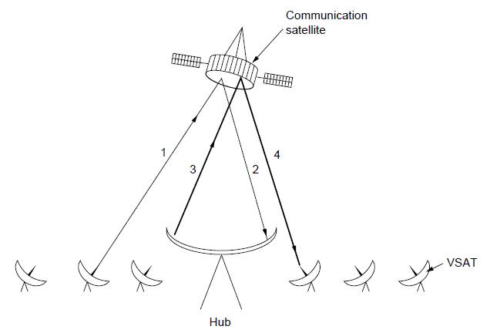
Geostationary Satellites (2)
VSATs using a hub.
Computer Networks, Fifth Edition by Andrew Tanenbaum and David Wetherall, © Pearson Education-Prentice Hall, 2011

Slide 32
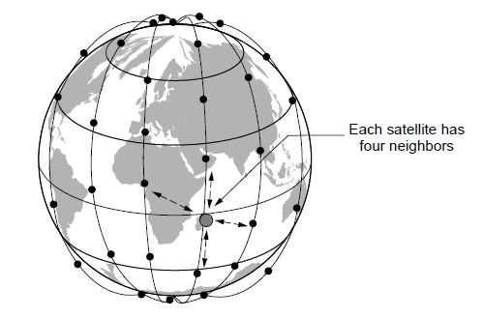
Low-Earth Orbit Satellites (1)
The Iridium satellites form six necklaces
around the earth.
Computer Networks, Fifth Edition by Andrew Tanenbaum and David Wetherall, © Pearson Education-Prentice Hall, 2011

Slide 33
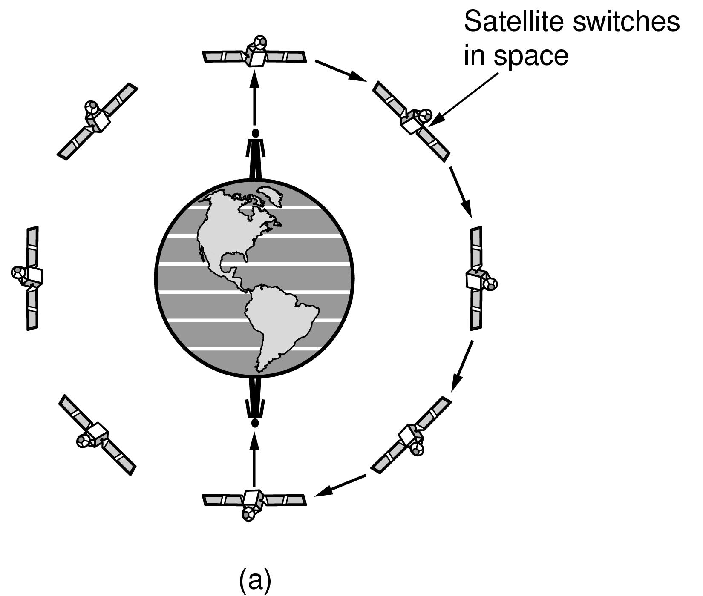
Low-Earth Orbit Satellites (2)
Relaying in space.
Computer Networks, Fifth Edition by Andrew Tanenbaum and David Wetherall, © Pearson Education-Prentice Hall, 2011

Slide 34
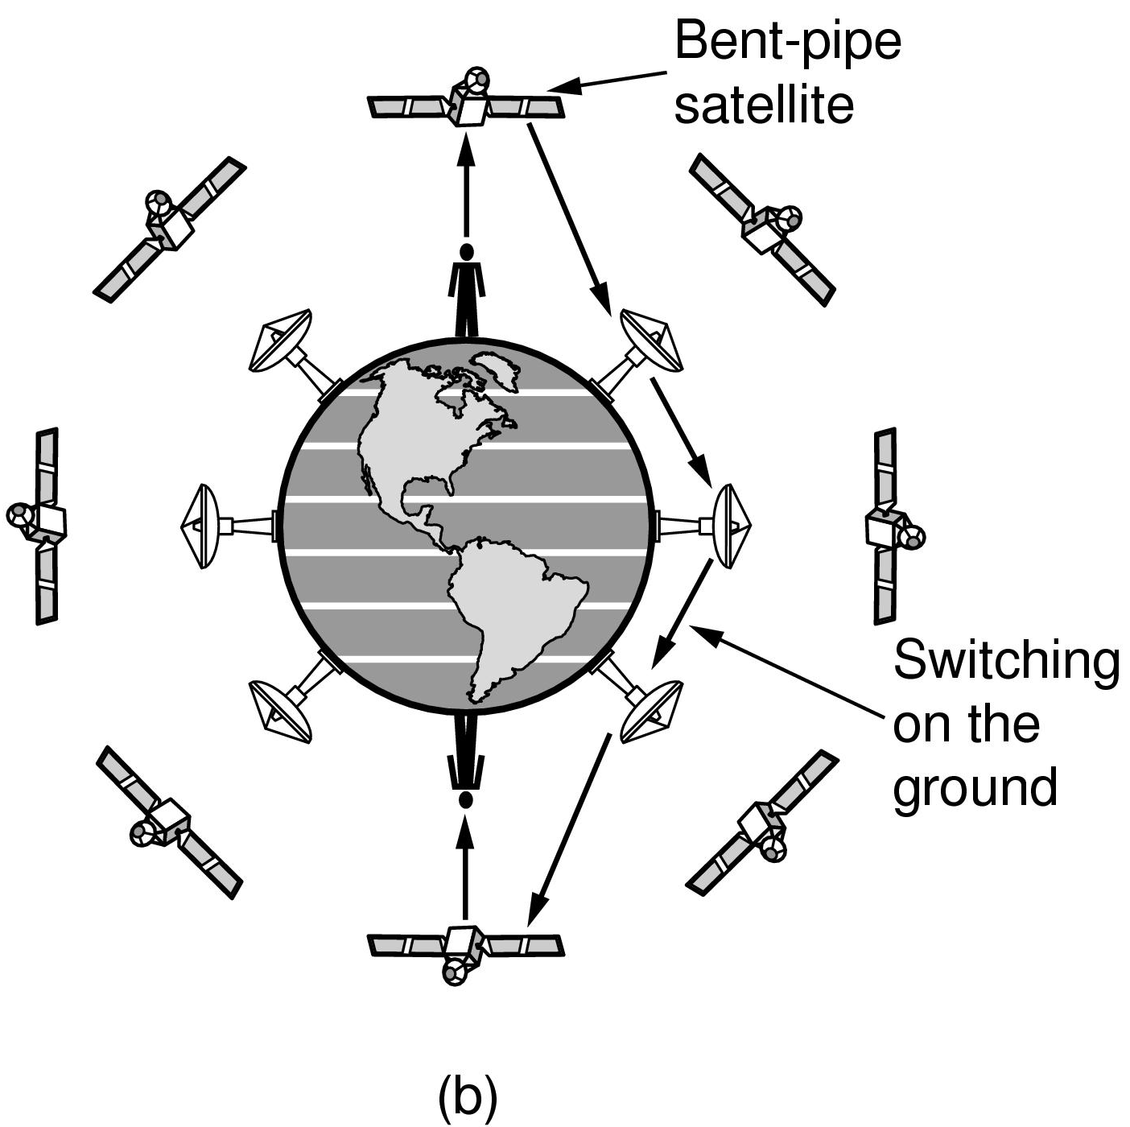
Low-Earth Orbit Satellites (3)
Relaying on the ground
Computer Networks, Fifth Edition by Andrew Tanenbaum and David Wetherall, © Pearson Education-Prentice Hall, 2011

Slide 35
Digital Modulation and Multiplexing
Baseband Transmission
Passband Transmission
Frequency Division Multiplexing
Time Division Multiplexing
Code Division Multiplexing
Computer Networks, Fifth Edition by Andrew Tanenbaum and David Wetherall, © Pearson Education-Prentice Hall, 2011

Slide 36
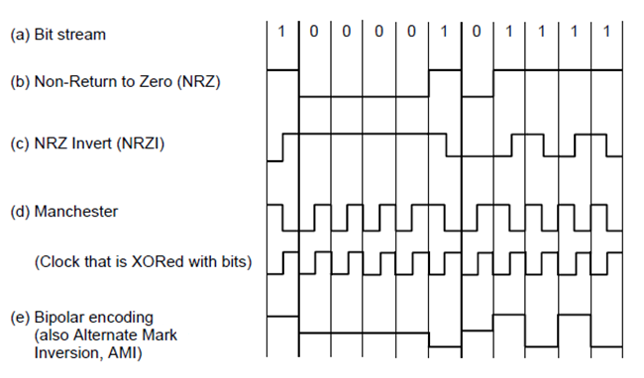
Baseband Transmission
Line codes: (a) Bits, (b) NRZ, (c) NRZI,
(d) Manchester, (e) Bipolar or AMI.
Computer Networks, Fifth Edition by Andrew Tanenbaum and David Wetherall, © Pearson Education-Prentice Hall, 2011

Slide 37
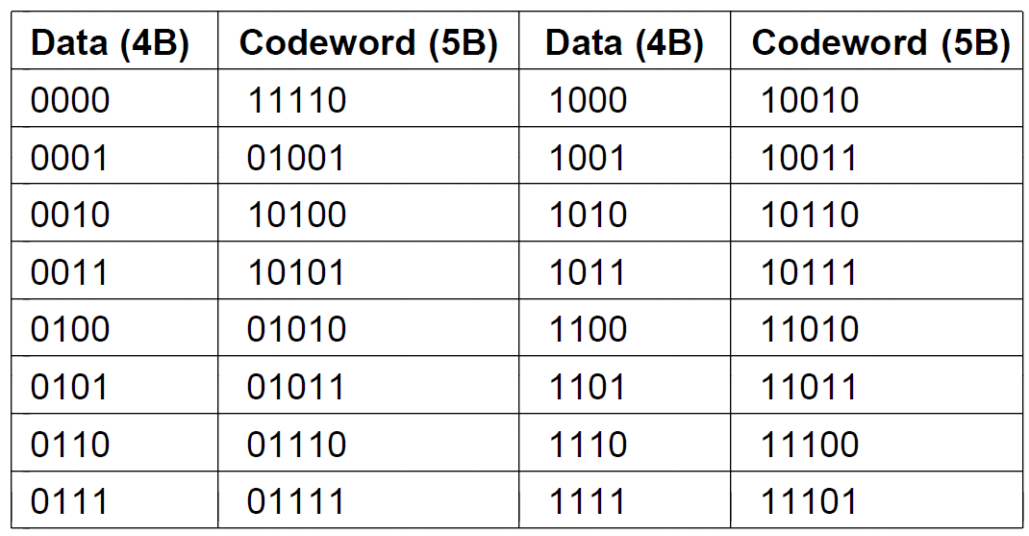
Clock Recovery
4B/5B mapping.
Computer Networks, Fifth Edition by Andrew Tanenbaum and David Wetherall, © Pearson Education-Prentice Hall, 2011

Slide 38
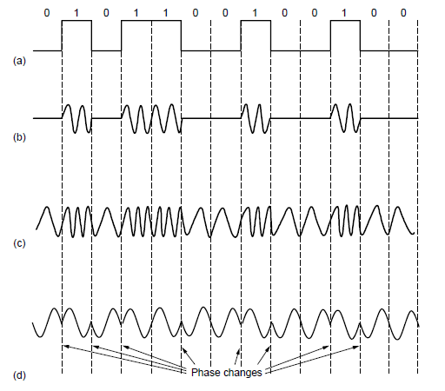
Passband Transmission (1)
(a) A binary signal. (b) Amplitude shift keying.
(c) Frequency shift keying. (d) Phase shift keying.
Computer Networks, Fifth Edition by Andrew Tanenbaum and David Wetherall, © Pearson Education-Prentice Hall, 2011

Slide 39
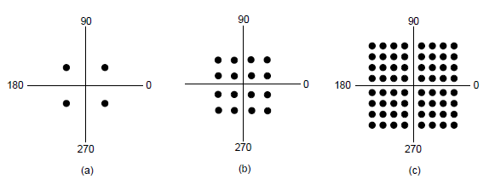
Passband Transmission (2)
(a) QPSK. (b) QAM-16. (c) QAM-64.
Computer Networks, Fifth Edition by Andrew Tanenbaum and David Wetherall, © Pearson Education-Prentice Hall, 2011

Slide 40
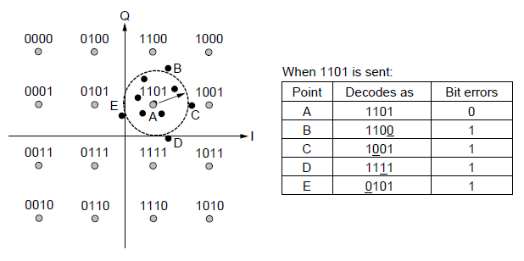
Frequency Division Multiplexing (1)
Gray-coded QAM-16.
Computer Networks, Fifth Edition by Andrew Tanenbaum and David Wetherall, © Pearson Education-Prentice Hall, 2011

Slide 41
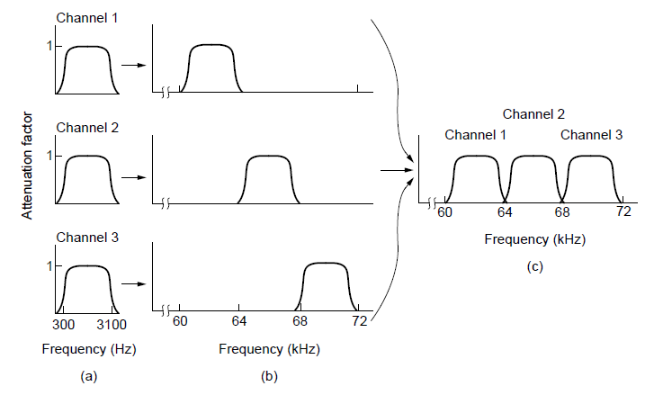
Frequency Division Multiplexing (2)
Frequency division multiplexing. (a) The original bandwidths.
(b) The bandwidths raised in frequency.
(c) The multiplexed channel.
Computer Networks, Fifth Edition by Andrew Tanenbaum and David Wetherall, © Pearson Education-Prentice Hall, 2011

Slide 42
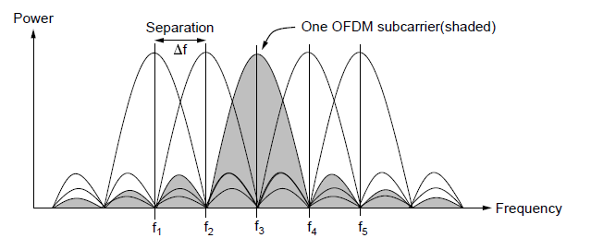
Frequency Division Multiplexing (3)
Orthogonal frequency division
multiplexing (OFDM).
Computer Networks, Fifth Edition by Andrew Tanenbaum and David Wetherall, © Pearson Education-Prentice Hall, 2011

Slide 43
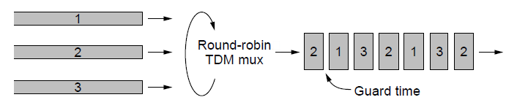
Time Division Multiplexing
Time Division Multiplexing (TDM).
Computer Networks, Fifth Edition by Andrew Tanenbaum and David Wetherall, © Pearson Education-Prentice Hall, 2011

Slide 44
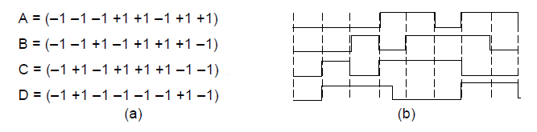
Code Division Multiplexing (1)
Chip sequences for four stations.
Signals the sequences represent
Computer Networks, Fifth Edition by Andrew Tanenbaum and David Wetherall, © Pearson Education-Prentice Hall, 2011

Slide 45
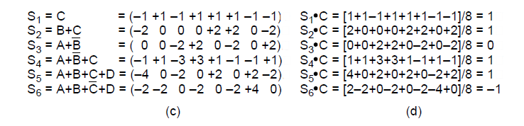
Code Division Multiplexing (2)
Six examples of transmissions.
Recovery of station C’s
Computer Networks, Fifth Edition by Andrew Tanenbaum and David Wetherall, © Pearson Education-Prentice Hall, 2011

Slide 46
The Public Switched Telephone Network
Structure of the telephone system
Politics of telephones
Local loop: modems, ADSL, and fiber
Trunks and multiplexing
Switching
Computer Networks, Fifth Edition by Andrew Tanenbaum and David Wetherall, © Pearson Education-Prentice Hall, 2011

Slide 47
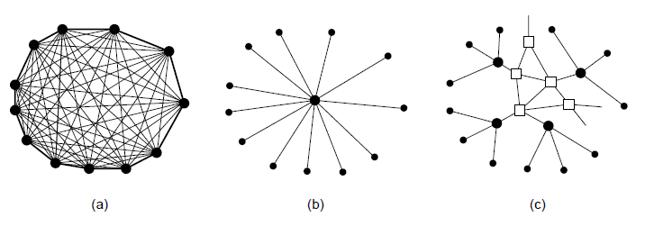
Structure of the Telephone System (1)
Fully interconnected network.
Centralized switch.
Two-level hierarchy.
Computer Networks, Fifth Edition by Andrew Tanenbaum and David Wetherall, © Pearson Education-Prentice Hall, 2011

Slide 48
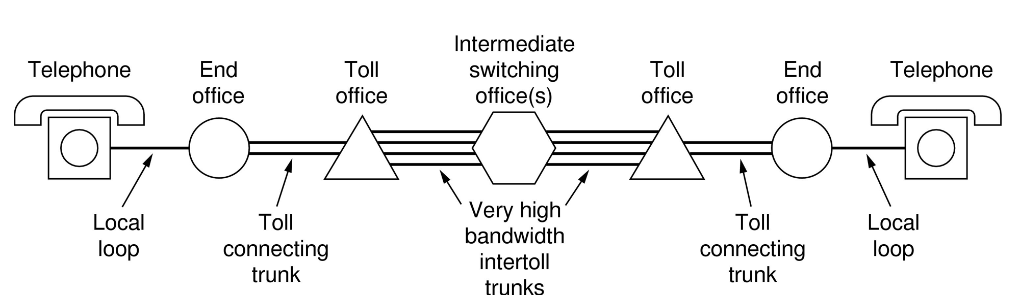
Structure of the Telephone System (2)
A typical circuit route for a long-distance call.
Computer Networks, Fifth Edition by Andrew Tanenbaum and David Wetherall, © Pearson Education-Prentice Hall, 2011

Slide 49
Structure of the Telephone System (3)
Major Components
Local loops analog twisted pairs to houses, businesses).
Trunks (digital fiber optic links between switching offices).
Switching offices (calls are moved from one trunk to another).
Computer Networks, Fifth Edition by Andrew Tanenbaum and David Wetherall, © Pearson Education-Prentice Hall, 2011

Slide 50
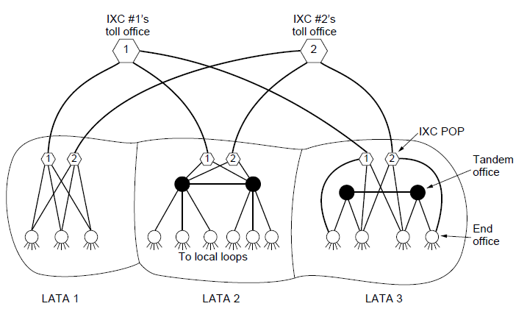
The Politics of Telephones
The relationship of LATAs, LECs, and IXCs. Circles are LEC switching offices. Hexagons belong to
IXC whose number is in it.
Computer Networks, Fifth Edition by Andrew Tanenbaum and David Wetherall, © Pearson Education-Prentice Hall, 2011

Slide 51
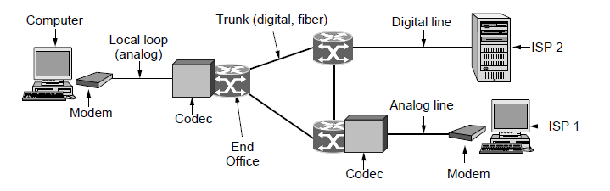
Telephone Modems
Use of both analog and digital transmission for computer -to-computer call. Conversion done by modems and codecs.
Computer Networks, Fifth Edition by Andrew Tanenbaum and David Wetherall, © Pearson Education-Prentice Hall, 2011

Slide 52
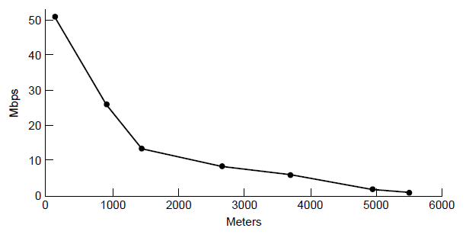
Digital Subscriber Lines (1)
Bandwidth versus distance over Category 3
UTP for DSL.
Computer Networks, Fifth Edition by Andrew Tanenbaum and David Wetherall, © Pearson Education-Prentice Hall, 2011

Slide 53
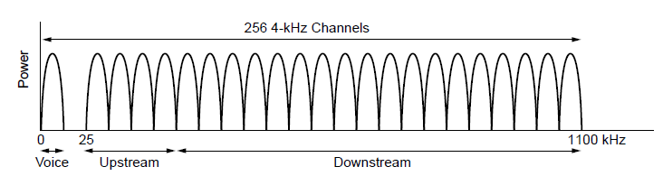
Digital Subscriber Lines (2)
Operation of ADSL using discrete
multitone modulation.
Computer Networks, Fifth Edition by Andrew Tanenbaum and David Wetherall, © Pearson Education-Prentice Hall, 2011

Slide 54
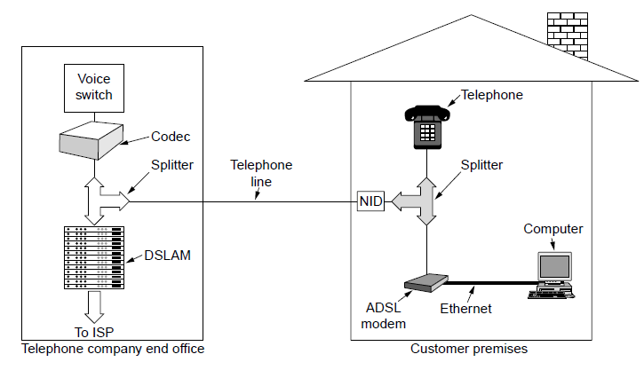
Digital Subscriber Lines (3)
A typical ADSL equipment configuration.
Computer Networks, Fifth Edition by Andrew Tanenbaum and David Wetherall, © Pearson Education-Prentice Hall, 2011

Slide 55
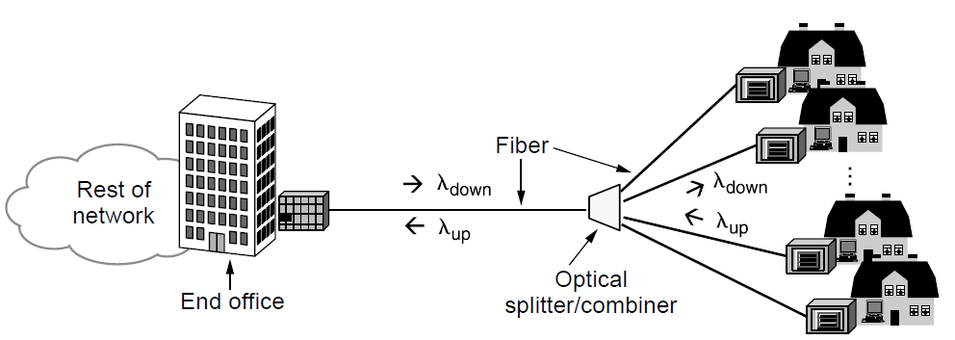
Fiber To The Home
Passive optical network for Fiber To The Home.
Computer Networks, Fifth Edition by Andrew Tanenbaum and David Wetherall, © Pearson Education-Prentice Hall, 2011

Slide 56
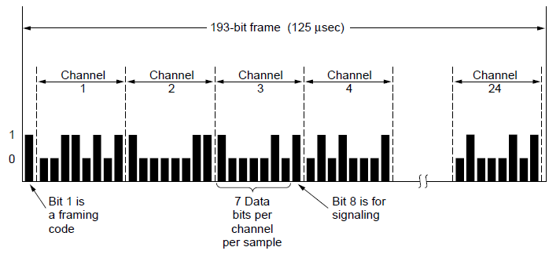
Time Division Multiplexing (1)
The T1 carrier (1.544 Mbps).
Computer Networks, Fifth Edition by Andrew Tanenbaum and David Wetherall, © Pearson Education-Prentice Hall, 2011

Slide 57
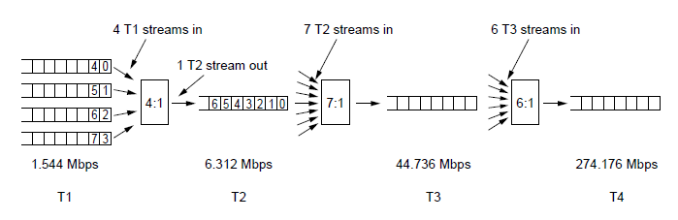
Time Division Multiplexing (2)
Multiplexing T1 streams into higher carriers
Computer Networks, Fifth Edition by Andrew Tanenbaum and David Wetherall, © Pearson Education-Prentice Hall, 2011

Slide 58
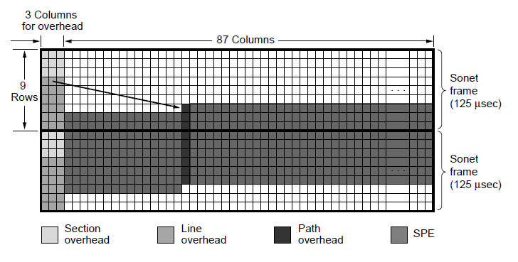
SONET/SDH (1)
Two back-to-back SONET frames.
Computer Networks, Fifth Edition by Andrew Tanenbaum and David Wetherall, © Pearson Education-Prentice Hall, 2011

Slide 59
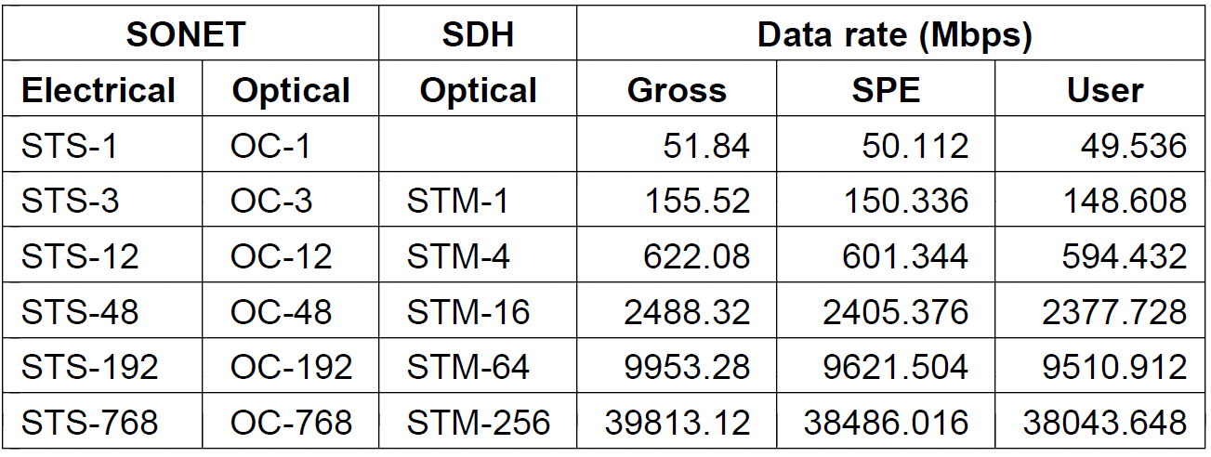
SONET/SDH (2)
SONET and SDH multiplex rates.
Computer Networks, Fifth Edition by Andrew Tanenbaum and David Wetherall, © Pearson Education-Prentice Hall, 2011

Slide 60
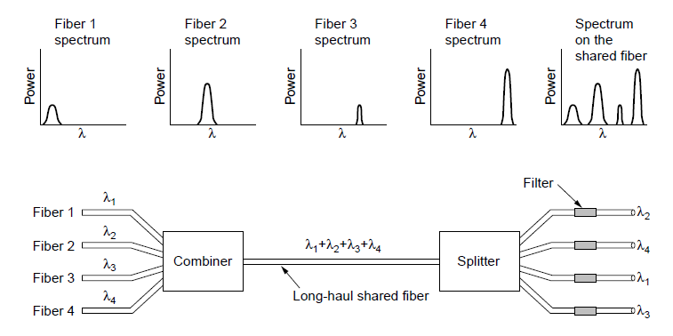
Wavelength Division Multiplexing
Wavelength division multiplexing
Computer Networks, Fifth Edition by Andrew Tanenbaum and David Wetherall, © Pearson Education-Prentice Hall, 2011

Slide 61

Circuit Switching/Packet Switching (1)
(a) Circuit switching. (b) Packet switching.
Computer Networks, Fifth Edition by Andrew Tanenbaum and David Wetherall, © Pearson Education-Prentice Hall, 2011

Slide 62

Circuit Switching/Packet Switching (2)
Timing of events in (a) circuit switching,
(b) packet switching
Computer Networks, Fifth Edition by Andrew Tanenbaum and David Wetherall, © Pearson Education-Prentice Hall, 2011

Slide 63

Circuit Switching/Packet Switching (3)
A comparison of circuit-switched and packet-switched networks.
Computer Networks, Fifth Edition by Andrew Tanenbaum and David Wetherall, © Pearson Education-Prentice Hall, 2011

Slide 64
Mobile Telephone System
First-Generation (1G) Mobile Phones Analog Voice
Second-Generation (2G) Mobile Phones Digital Voice
Third-Generation (3G) Mobile Phones Digital Voice + Data
Computer Networks, Fifth Edition by Andrew Tanenbaum and David Wetherall, © Pearson Education-Prentice Hall, 2011

Slide 65

Advanced Mobile Phone System
(a) Frequencies are not reused in adjacent cells.
(b) To add more users, smaller cells can be used.
Computer Networks, Fifth Edition by Andrew Tanenbaum and David Wetherall, © Pearson Education-Prentice Hall, 2011

Slide 66

GSM—The Global System for Mobile Communications (1)
GSM mobile network architecture.
Computer Networks, Fifth Edition by Andrew Tanenbaum and David Wetherall, © Pearson Education-Prentice Hall, 2011

Slide 67

GSM—The Global System for Mobile Communications (2)
GSM uses 124 frequency channels, each of which uses an eight-slot TDM system.
Computer Networks, Fifth Edition by Andrew Tanenbaum and David Wetherall, © Pearson Education-Prentice Hall, 2011

Slide 68

GSM—The Global System for Mobile Communications (3)
A portion of the GSM framing structure.
Computer Networks, Fifth Edition by Andrew Tanenbaum and David Wetherall, © Pearson Education-Prentice Hall, 2011

Slide 69
Digital Voice and Data (1)
Basic services intend by IMT-2000 network
High-quality voice transmission.
Messaging (replacing email, fax, SMS, chat).
Multimedia (music, videos, films, television).
Internet access (Web surfing, incl. audio, video).
Computer Networks, Fifth Edition by Andrew Tanenbaum and David Wetherall, © Pearson Education-Prentice Hall, 2011

Slide 70

Digital Voice and Data (2)
Soft handoff (a) before, (b) during, and (c) after.
Computer Networks, Fifth Edition by Andrew Tanenbaum and David Wetherall, © Pearson Education-Prentice Hall, 2011

Slide 71
Cable Television
Community antenna television
Internet over cable
Spectrum allocation
Cable modems
ADSL versus cable
Computer Networks, Fifth Edition by Andrew Tanenbaum and David Wetherall, © Pearson Education-Prentice Hall, 2011

Slide 72

Community Antenna Television
An early cable television system
Computer Networks, Fifth Edition by Andrew Tanenbaum and David Wetherall, © Pearson Education-Prentice Hall, 2011

Slide 73

Internet over Cable (1)
Cable television
Computer Networks, Fifth Edition by Andrew Tanenbaum and David Wetherall, © Pearson Education-Prentice Hall, 2011

Slide 74

Internet over Cable (2)
The fixed telephone system.
Computer Networks, Fifth Edition by Andrew Tanenbaum and David Wetherall, © Pearson Education-Prentice Hall, 2011

Slide 75

Spectrum Allocation
Frequency allocation in a typical
cable TV system used for Internet access.
Computer Networks, Fifth Edition by Andrew Tanenbaum and David Wetherall, © Pearson Education-Prentice Hall, 2011

Slide 76

Cable Modems
Typical details of the upstream and downstream
channels in North America.
Computer Networks, Fifth Edition by Andrew Tanenbaum and David Wetherall, © Pearson Education-Prentice Hall, 2011

Slide 77
End
Chapter 2
Computer Networks, Fifth Edition by Andrew Tanenbaum and David Wetherall, © Pearson Education-Prentice Hall, 2011

